Slide 1
Working with Workgroups and Domains
Lesson 9

Slide 2
Objectives
Understand users and groups
Create and manage local users and groups
Understand the difference between workgroups and domains
Configure user account control (UAC)
Notes:
Outline the material you are going to cover in this lesson. Do not go into detail as each of these points will be expanded on in the lesson. You may also want to mention the Technology Skills that are being covered for the Certification exam also.

Slide 3
Working with Users and Groups
Users
  Fundamental unit of identity
  Has two meanings
    Physical person
    Operating system element
Notes:
Introduce Users and Groups and basically what they are used for in a Windows network. These concepts will be expanded on in the different networking environments in the next slides.

Slide 4
Working with Users and Groups
User Accounts are vital to the following two functions;
  Authentication: The process of verifying that the identity of the person operating the computer matches that of the user account the person is using to gain access
  Authorization: The process of granting an authenticated user a specific degree of access to a specific computer or data resources
Notes:
Introduce Users and Groups and basically what they are used for in a Windows network. These concepts will be expanded on in the different networking environments in the next slides.

Slide 5
Working with Users and Groups
User based permission systems include
  NTFS
  Share
  Registry
  Active directory
Notes:
Introduce Users and Groups and basically what they are used for in a Windows network. These concepts will be expanded on in the different networking environments in the next slides.

Slide 6
Working with Users and Groups
User rights
  Specific operating system tasks which can be performed by certain users designated by an administrator
  Examples
    Shut down
    Allow log on through terminal services
Notes:
Introduce Users and Groups and basically what they are used for in a Windows network. These concepts will be expanded on in the different networking environments in the next slides.

Slide 7
Working with Users and Groups
Groups are a collection of users
Administrators can assign permissions and user rights to any group
Any user in that group automatically inherits the permissions and user rights of the group
In most domain networking situations rights and permissions are assigned to groups and users are placed in those groups.
Notes:
Introduce Users and Groups and basically what they are used for in a Windows network. These concepts will be expanded on in the different networking environments in the next slides.

Slide 8
Understanding Local and Domain Users
Windows 7 has two completely separate user account systems base on whether you are a local or domain user.
The account systems are;
  Workgroup
  Domain
There is a third system Homegroup strictly designed for networks computers in a home setting.
Notes:
It is important to understand the different network

Slide 9
Introducing the Homegroup
Simplified networking
Allows users on a home network to share the contents of their libraries without creating user accounts and permissions
Notes:
Refer to Lesson 6 for information about HOW to create a HomeGroup and for additional information.

Slide 10
Introducing the Workgroup
Peer-to-peer network
Each computer can function as both a server and a client
Each computer has its own set of users and groups to control access to its own resources
Small networks, little security required
Notes:
Discuss the Workgroup and how a user logs on to each computer on the network. Discuss pass-through authentication and why workgroups are only intended for small, informal networks.

Slide 11
Introducing the Domain
Collection of computers that utilize a central directory service for authentication and authorization
At least one Domain Controller is required
Domain Controller
Notes:
Discuss the properties of a domain and how users logon and gain access to resources. It may be useful to use information from Lesson 6 about how users are authenticated and authorized.

Slide 12
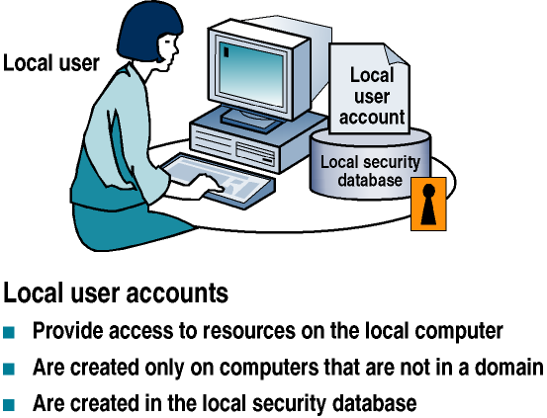
Local User Accounts
Notes:
Explain the properties of a Local User Account. See the properties sheet on the next slide.

Slide 13
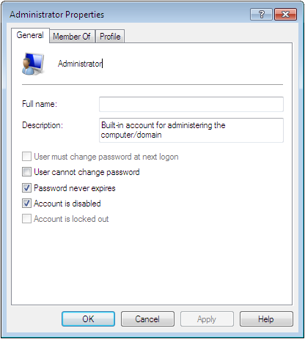
Local User Account Properties

Slide 14
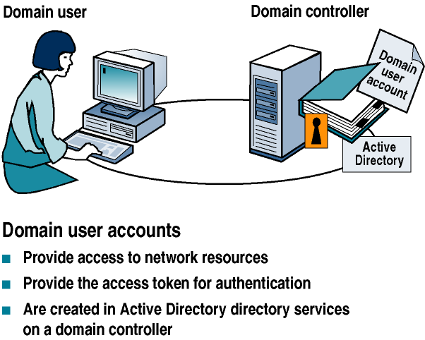
Domain User Accounts
Notes:
Explain how a user account works in a Domain Environment. Refer to the Domain User Account properties sheet on the next slide.

Slide 15
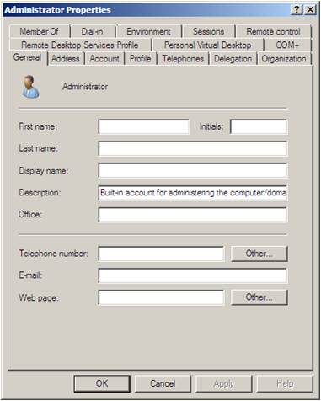
Domain Account Properties
Notes:
Point to all of the additional tabs available on the Domain Account’s properties sheet.

Slide 16
Introducing Built-In Local Users
Administrator
  Member of Administrators group
  Left disabled during setup and has no password
New User Account
  Installer must specify a name during setup
  Becomes a member of the administrators group
  Asked for a password
Notes:
Explain the 3 built-in local user accounts and their purpose.

Slide 17
Introducing Built-In Local Users
Guest
  Used for people that need temporary access
  Disabled by default during OS installation.
  Member of the Guest group which provides minimum access rights.
After OS installation you should consider enabling the Administrator Account and giving it a strong password.
Notes:
Explain the 3 built-in local user accounts and their purpose.

Slide 18
In lab 12 you will learn how to enable the administrators account and how to create a strong password system.

Slide 19
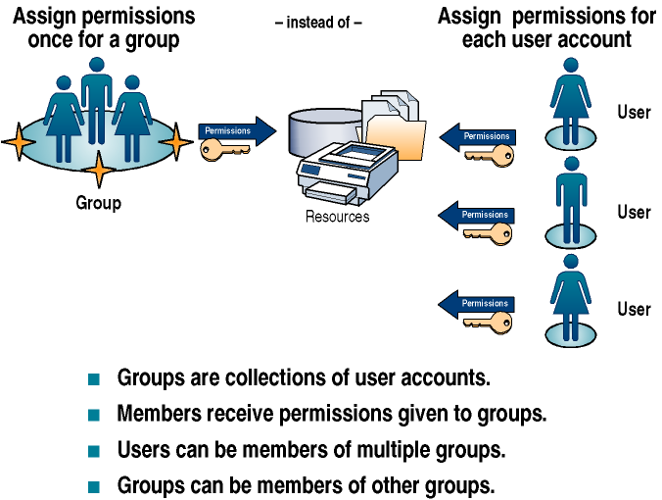
Understanding Local and Domain Groups
Notes:
Use the diagram to explain what a group is and what it is used for.

Slide 20
Using Local Groups
You can only use local groups on the computer where you create them.
Only local users from the same computer can be members of local groups.
When the computer is a member of an AD DS domain, local groups can have domain users and domain global groups as members.
Local groups cannot have other local groups as members. However, they can have domain groups as members.
You can only assign permissions to local groups when you are controlling access to resources on the local computer.
You cannot create local groups on a Windows server computer that is functioning as a domain controller.
Notes:
Describe the restrictions placed on Local Groups.

Slide 21
Introducing Built-In Local Groups
Administrators
Backup operators
Power users
Guests
Remote desktop users
Users
See table 9-2 in book for explanation of each local group.
Notes:
These are some of the basic Built-in Local groups on a Windows 7 computer. The full list is in the book and additional groups are added if different services are running on the computer. Explain these basic groups, what users are in them by default, and what they are used for.

Slide 22
Introducing Special Identities
Special identities are groups whose membership is controlled by the operating system itself, not by administrators or individual users
User accounts become “members” of these special groups based on the type of system activity they participate in
you cannot modify the “membership” of these groups directly.
Notes:
A special identity is essentially a placeholder for a collection of users with a similar characteristic. For example, the Authenticated Users special identity represents all of the users that are logged on to the computer at a given instant. You can assign rights and permissions to a special identity just as you would to a group.
Some of the special identities are on the slide. Explain each one and refer to the full list in the book.

Slide 23
Introducing Special Identities
See table 9-3 for and explanation of the individual special identities.
Notes:
A special identity is essentially a placeholder for a collection of users with a similar characteristic. For example, the Authenticated Users special identity represents all of the users that are logged on to the computer at a given instant. You can assign rights and permissions to a special identity just as you would to a group.
Some of the special identities are on the slide. Explain each one and refer to the full list in the book.

Slide 24
Creating and Managing
Local Users and Groups
User accounts – In the Control Panel
Local users and groups – MMC snap-in
Notes:
Explain when each of these tools is used to create and manage users and groups. More detail will be provided in the next slides.

Slide 25
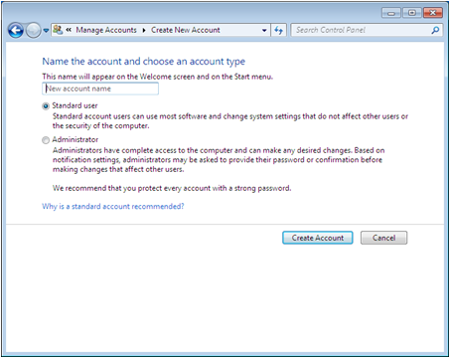
Using the User Accounts Control Panel
Intended for users with less experience
Simplified interface
Limited access
Cannot create
or manage groups
Notes:
Explain in more detail who would use this tool and what the advantages and limitations are.

Slide 26
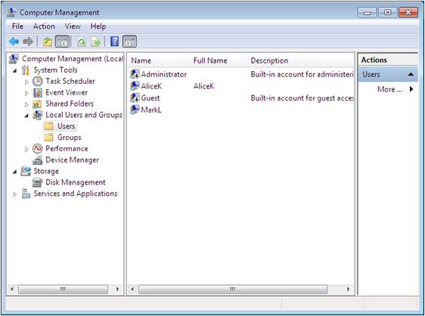
Using the Local Users and Groups Snap-In
Gives more access to user account properties
Allows you to create and manage groups
Notes:
Explain in more detail who would use this tool and what can be done with this tool that cannot be done with the User Accounts Control Panel option.

Slide 27
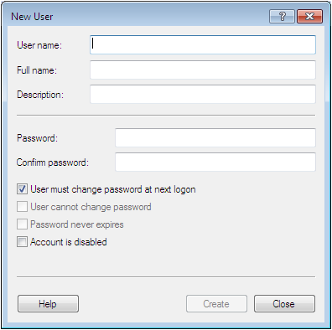
Creating a Local User
Notes:
Describe the information that must be put in the New User dialog box in order to create a local user. Describe the password options in detail and give examples of when you would use each.

Slide 28
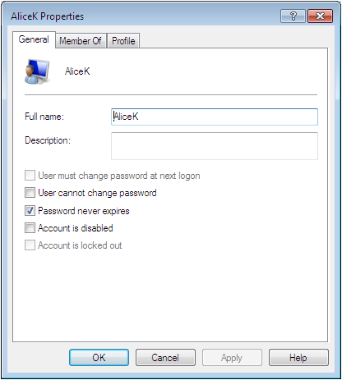
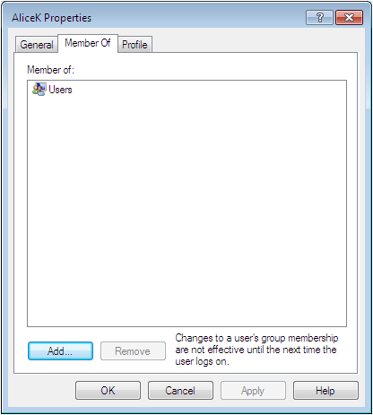
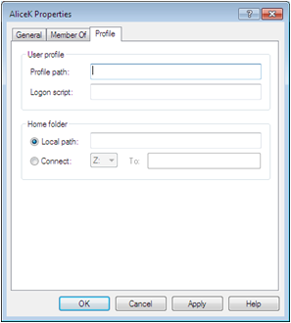
Managing a User
Can change all user properties except username
Change group membership
Set profile information
Notes:
Describe how to change user account properties. Describe the 4 options on the Profile tab.

Slide 29
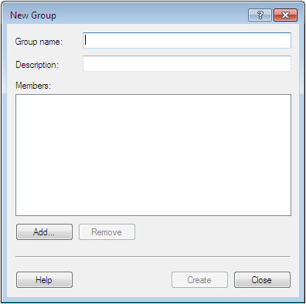
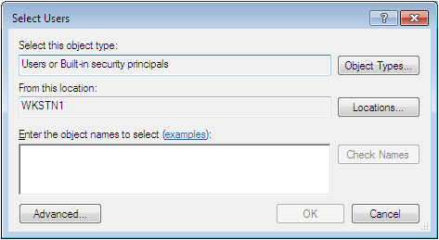
Creating a Local Group
Notes:
Describe the process of creating a local group and what information needs to be entered in the fields on the New Group screen.

Slide 30
Understanding User Profiles
Local user profile
  A profile that Windows 7 automatically creates when each user logs on to the computer for the first time.
  The local user profile is stored on the computer's local hard disk
Notes:
Describe the 3 types of profiles.

Slide 31
Understanding User Profiles
Roaming user profile
  A copy of a local user profile that is stored on a shared server drive, making it accessible from anywhere on the network
  Changes as changes are made to the local profile.
Notes:
Describe the 3 types of profiles.

Slide 32
Understanding User Profiles
Mandatory user profile
  A roaming profile that users cannot change
  Administrators use mandatory user profiles ., to .enforce particular desktop settings for individuals or for a group of users.
  A read only profile.
Notes:
Describe the 3 types of profiles.

Slide 33
Introducing User Account Control (UAC)
Because many users log on to the system using Administrative Accounts (leaving the system vulnerable to malware attacks) Microsoft implemented UAC.
Under UAC, administrators are issued two access tokens—1 standard token and 1 administrative token.
Best Practice is to logon as a standard user unless performing administrative tasks.
Notes:
Discuss how users and technical specialists login as administrative users to make it convenient when administrative tasks need to be done. Discuss the problems with doing this and then introduce UAC.

Slide 34
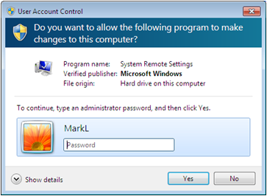
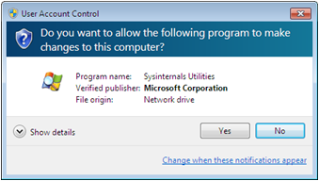
Performing Administrative Tasks
Standard User Account
Administrative Account
System displays a credential prompt where administrative account information must be entered
Switches from standard user token to administrative token
Generates an elevation prompt
Notes:
Describe the difference between performing an Administrative Task with a Standard Account vs with an Administrative Account

Slide 35
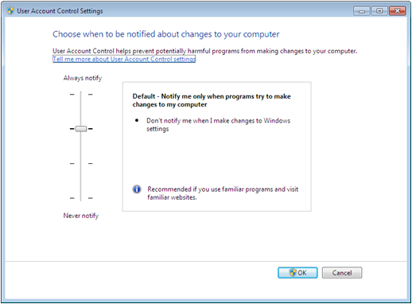
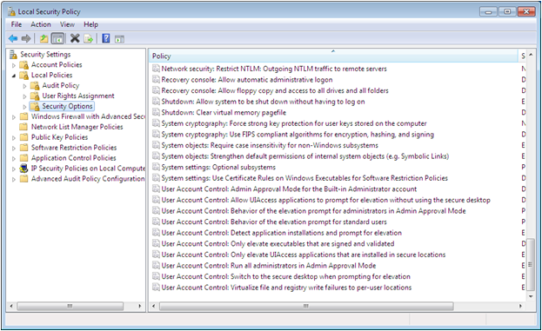
Configuring User Account Control
Can be configured or disabled
Notes:
Explain the settings that can be changed in User Account Control Settings and the Local Security Policy. Note that is can also be completely disabled.

Slide 36
Skills Summary
The user account is the fundamental unit of identity in the Windows operating systems.
A group is a collection of users.
A workgroup is a collection of computers that are all peers, and can act as a client or server.
A domain is a collection of computers that all utilize a central directory service for authentication and authorization.
Built-in local groups are equipped with the permissions and rights needed to perform certain tasks.
Notes:
Review the Skill Summary to wrap up your lesson.

Slide 37
Skills Summary (cont.)
Windows 7 provides two separate interfaces for creating and managing local user accounts: the User Accounts control panel and the Local Users and Group snap-in.
The three profile types are local, roaming, and mandatory.
User Account Control (UAC) allows an administrative user to perform regular user tasks as a standard user, and switches to an administrative token only to perform administrative tasks.

